Slide 1
Understanding z scores (measures of variability)

Slide 2
For example; marks scored by two Students in exams
# 1 Exam scores | # 2 Exam scores
85 | 88
95 | 79
75 | 91
80 | 85
90 | 82
Mean # 1 | Mean # 2
85 | 85

Slide 3
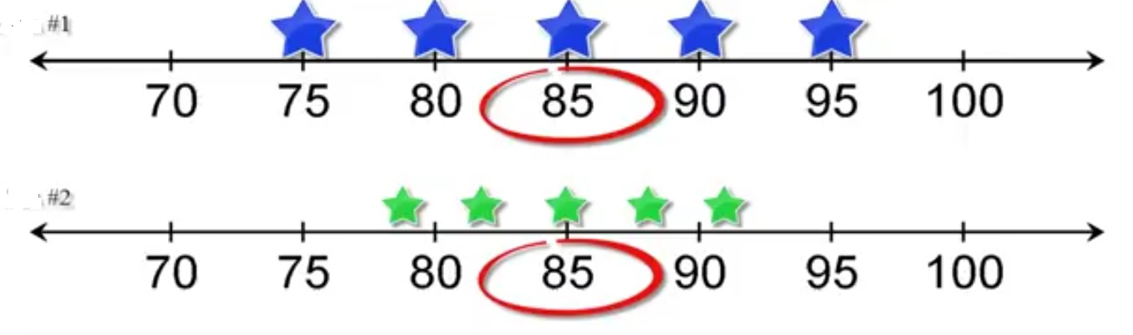
Distribution of marks score
# 1 Exam scores | # 2 Exam scores
85 | 88
95 | 79
75 | 91
80 | 85
90 | 82
Mean = 85 (same in both cases)

Slide 4
z score is useful for?
How far is the raw score from the mean?
Z score helps you know that point (distance)
How many standard deviation below and above the point is located from the mean?
Z score ignores measurement units.
Mean value of z score is set at 0 and below the mean is negative and above the mean is positive.

Slide 5
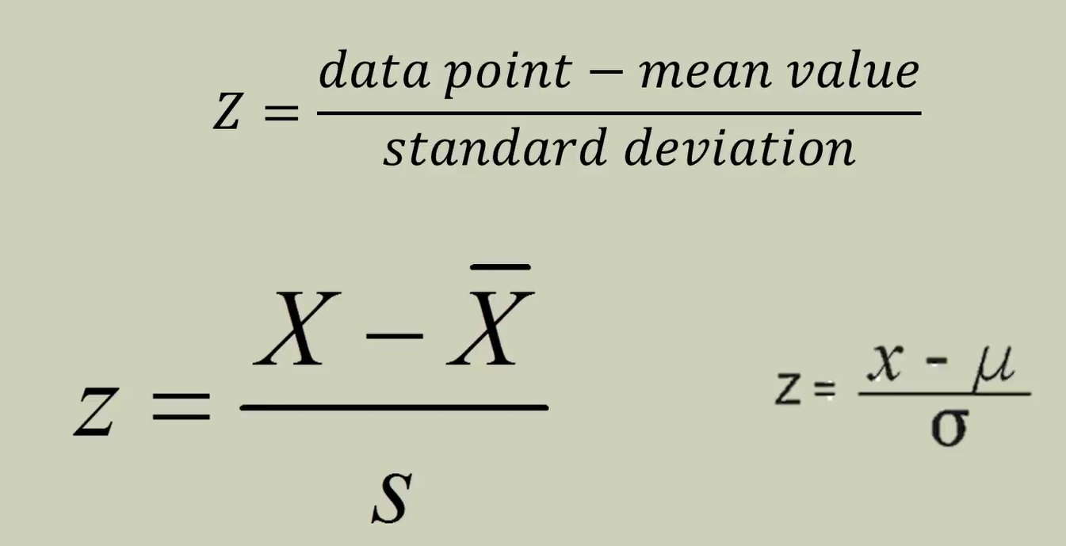
The z score formula: The relationship of z score with standard deviation and raw score

Slide 6
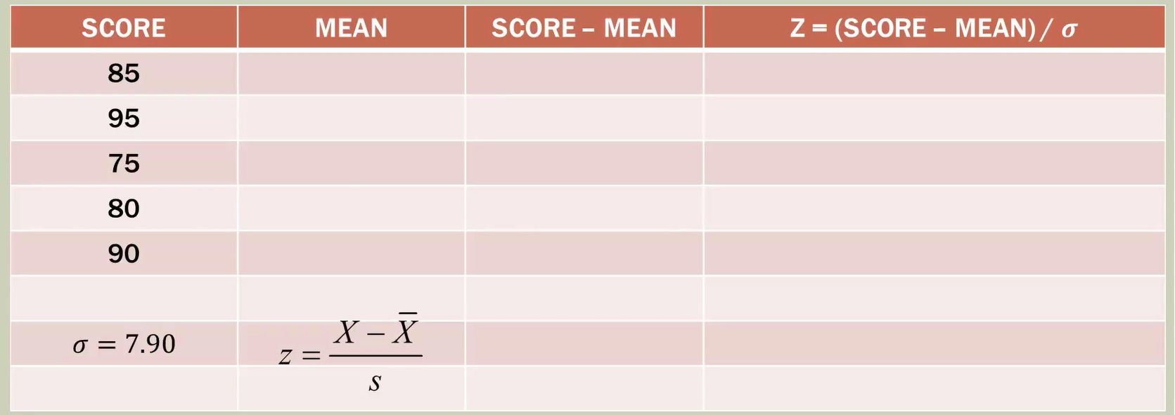
Student # 1 example: Lets calculate z value

Slide 7
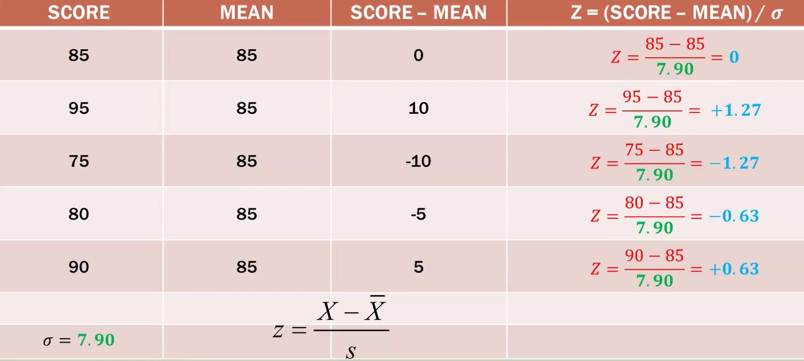
Z scores from student # 1

Slide 8

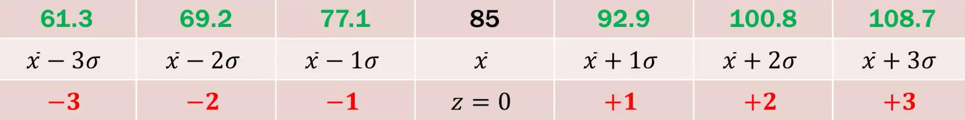
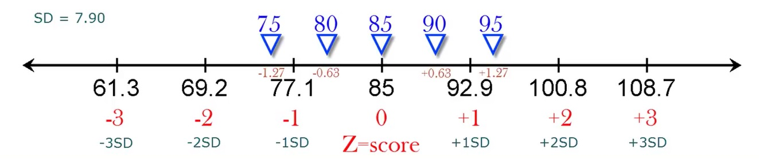
Z score visualization

Slide 9
Analyzing the data
Suppose a score in Math exam among college students are normally distributed with a mean of 500 and a standard deviation of 100. If a student scores a 700, what would be her z-score?
Her z-score would be 2 which means her score is two standard deviations above the mean.

Slide 10
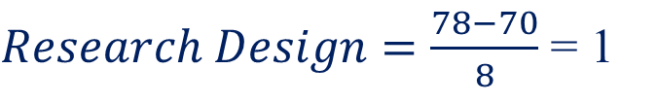

Contd….
Exercise 2. A set of Research design test scores has a mean of 70 and a standard deviation of 8. and a set of Statistics test scores has a mean of 74 and a standard deviation of 16. For which test would a score of 78 have a higher standing?
To solve: Find the z-score for each test.
The Research Design score would have the highest standing since it is 1 standard deviation above the mean while the Statistics score is only 0.25 standard deviation above the mean.

Slide 11
Standard Normal Distribution
z | .00 .01 .02 .03 .04 .05 .06 .07 .08 .09
0.0 0.1 0.2 0.3 0.4 0.5 0.6 0.7 0.8 0.9 1.0 1.1 1.2 1.3 1.4 1.5 1.6 1.7 1.8 1.9 2.0 2.1 2.2 2.3 2.4 2.5 2.6 2.7 2.8 2.9 3.0 | .5000 .5040 .5080 .5120 .5160 .5199 .5239 .5279 .5319 .5359 .5398 .5438 .5478 .5517 .5557 .5596 .5636 .5675 .5714 .5753 .5793 .5832 .5871 .5910 .5948 .5987 .6026 .6064 .6103 .6141 .6179 .6217 .6255 .6293 .6331 .6368 .6406 .6443 .6480 .6517 .6554 .6591 .6628 .6664 .6700 .6736 .6772 .6808 .6844 .6879 .6915 .6950 .6985 .7019 .7054 .7088 .7123 .7157 .7190 .7224 .7257 .7291 .7324 .7357 .7389 .7422 .7454 .7486 .7517 .7549 .7580 .7611 .7642 .7673 .7703 .7734 .7764 .7794 .7823 .7852 .7881 .7910 .7939 .7967 .7995 .8023 .8051 .8078 .8106 .8133 .8159 .8186 .8212 .8238 .8264 .8289 .8315 .8340 .8365 .8389 .8413 .8438 .8461 .8485 .8508 .8531 .8554 .8577 .8599 .8621 .8643 .8665 .8686 .8708 .8729 .8749 .8770 .8790 .8810 .8830 .8849 .8869 .8888 .8907 .8925 .8944 .8962 .8980 .8997 .9015 .9032 .9049 .9066 .9082 .9099 .9115 .9131 .9147 .9162 .9177 .9192 .9207 .9222 .9236 .9251 .9265 .9279 .9292 .9306 .9319 .9332 .9345 .9357 .9370 .9382 .9394 .9406 .9418 .9429 .9441 .9452 .9463 .9474 .9484 .9495 .9505 .9515 .9525 .9535 .9545 .9554 .9564 .9573 .9582 .9591 .9599 .9608 .9616 .9625 .9633 .9641 .9649 .9656 .9664 .9671 .9678 .9686 .9693 .9699 .9706 .9713 .9719 .9726 .9732 .9738 .9744 .9750 .9756 .9761 .9767 .9772 .9778 .9783 .9788 .9793 .9798 .9803 .9808 .9812 .9817 .9821 .9826 .9830 .9834 .9838 .9842 .9846 .9850 .9854 .9857 .9861 .9864 .9868 .9871 .9875 .9878 .9881 .9884 .9887 .9890 .9893 .9896 .9898 .9901 .9904 .9906 .9909 .9911 .9913 .9916 .9918 .9920 .9922 .9925 .9927 .9929 .9931 .9932 .9934 .9936 .9938 .9940 .9941 .9943 .9945 .9946 .9948 .9949 .9951 .9952 .9953 .9955 .9956 .9957 .9959 .9960 .9961 .9962 .9963 .9964 .9965 .9966 .9967 .9968 .9969 .9970 .9971 .9972 .9973 .9974 .9974 .9975 .9976 .9977 .9977 .9978 .9979 .9979 .9980 .9981 .9981 .9982 .9982 .9983 .9984 .9984 .9985 .9985 .9986 .9986 .9987 .9987 .9987 .9988 .9988 .9989 .9989 .9989 .9990 .9990
The table shows area to left of ‘z’ under standard normal curve

Slide 12
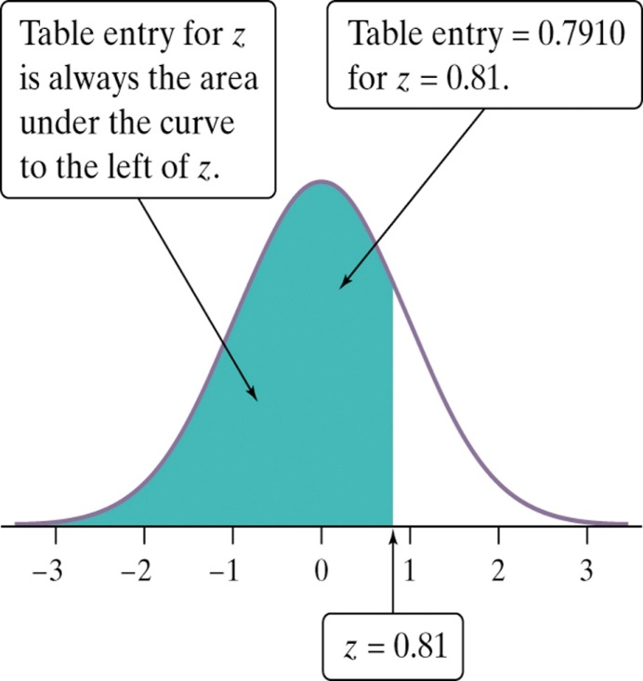
The Standard Normal Table
Suppose we want to find the proportion of observations from the standard Normal distribution that are less than 0.81.
We can use the Table:
P(z < 0.81) =
0.7910
Z | 0.00 | 0.01 | 0.02
0.7 | 0.7580 | 0.7611 | 0.7642
0.8 | 0.7881 | 0.7910 | 0.7939
0.9 | 0.8159 | 0.8186 | 0.8212

